Slide 1



THE GLAMHIVE
WHERE BEAUTY MEETS ELEGENCE
By: Smart Techs

Slide 2
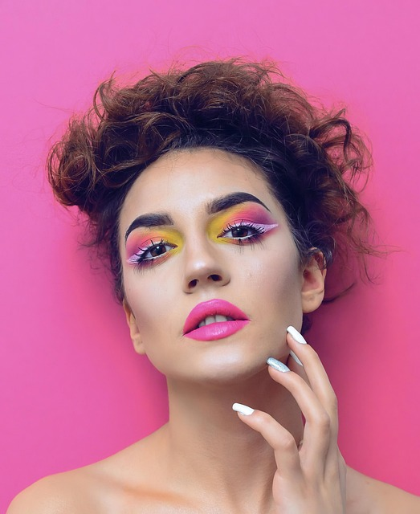
TABLE OF CONTENT
INTRODUCTION
CONTENT CREATION
BUSINESS PURPOSE
TARGET AUDIENCE
BUSINESS GOALS

Slide 3
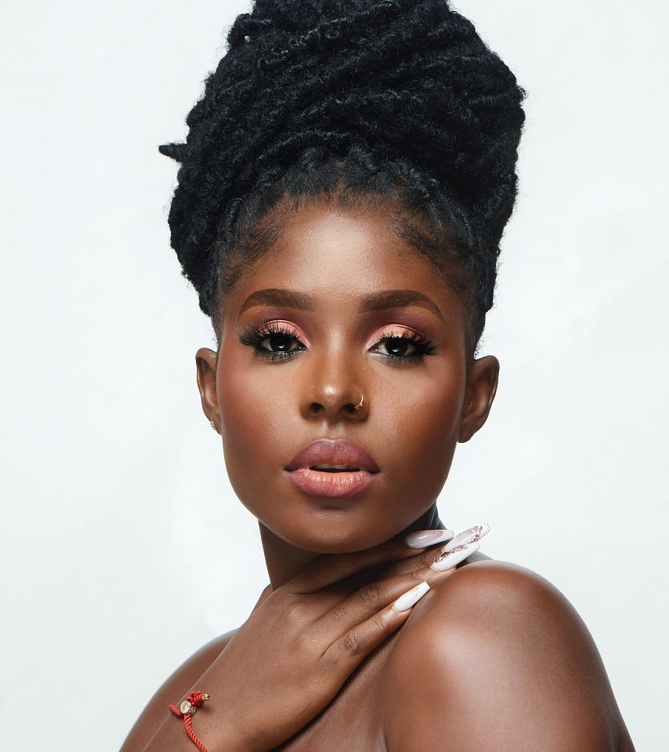
INTRODUCTION
Are you a beauty professional looking to attract more clients and streamline your booking process?
Glam Hive is here to help you grow your business by offering a dedicated platform where you can promote your services, showcase your work and simplify appointments.
Our platform makes it easy for new customers to find you and learn more about what you offer
Let your clients book an appointments directly through our website with ease. No more missed calls, or double booking, just a smooth, hassle-free booking experience.
Stay organized by managing your appointments and availability in one convenient place. Send reminders and updates to clients to reduce no-shows.

Slide 4
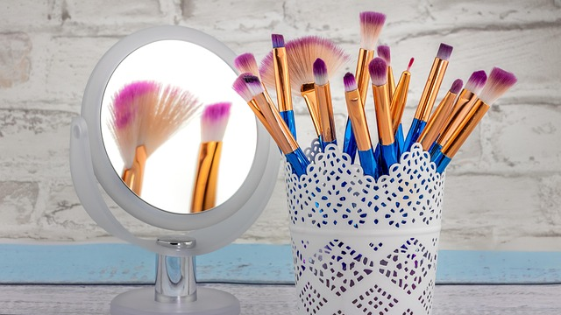
PURPOSE AND OUR AUDIENCES
PURPOSE:
Bridging the digital gap between beauty service providers and their customers.
AUDIENCE:
Beauty professionals seeking to give their business a digital presence.
Beauty professionals seeking to automate the booking and sales process of their services and products.
Beauty service seekers looking for an easy booking process.

Slide 5

BUSINESS Goals
Our business goal is to encourage beauty professional to manage appointments online, to reduce the need for phone calls or in person visits.
To help beauty professionals to interact with customers faster and save time.
A professional and friendly user website that can enhance your brands image and reputation.

Slide 6
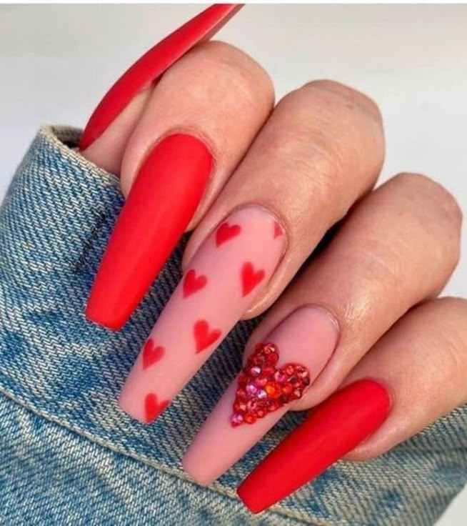
Content creation
In HTML we learned that text, images and links are arranged using tags such as <h1>, <p>, <a> and <div>.
CSS is what gives the web page its appearance and feel. It defines characteristics like layout, margins , fonts and colors to style html elements.
JavaScript gives a webpage functionality and interactivity. It makes it possible for features like form validation, interactive menus and real time changes through DOM.

